Slide 1

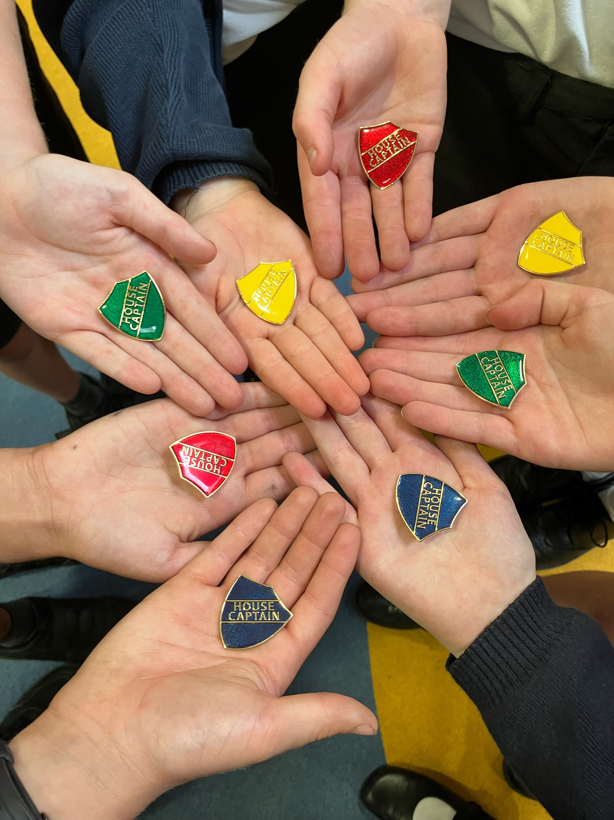
Growth and Goals:
Insights and Impact
Wednesday 23rd September 2026

Slide 2
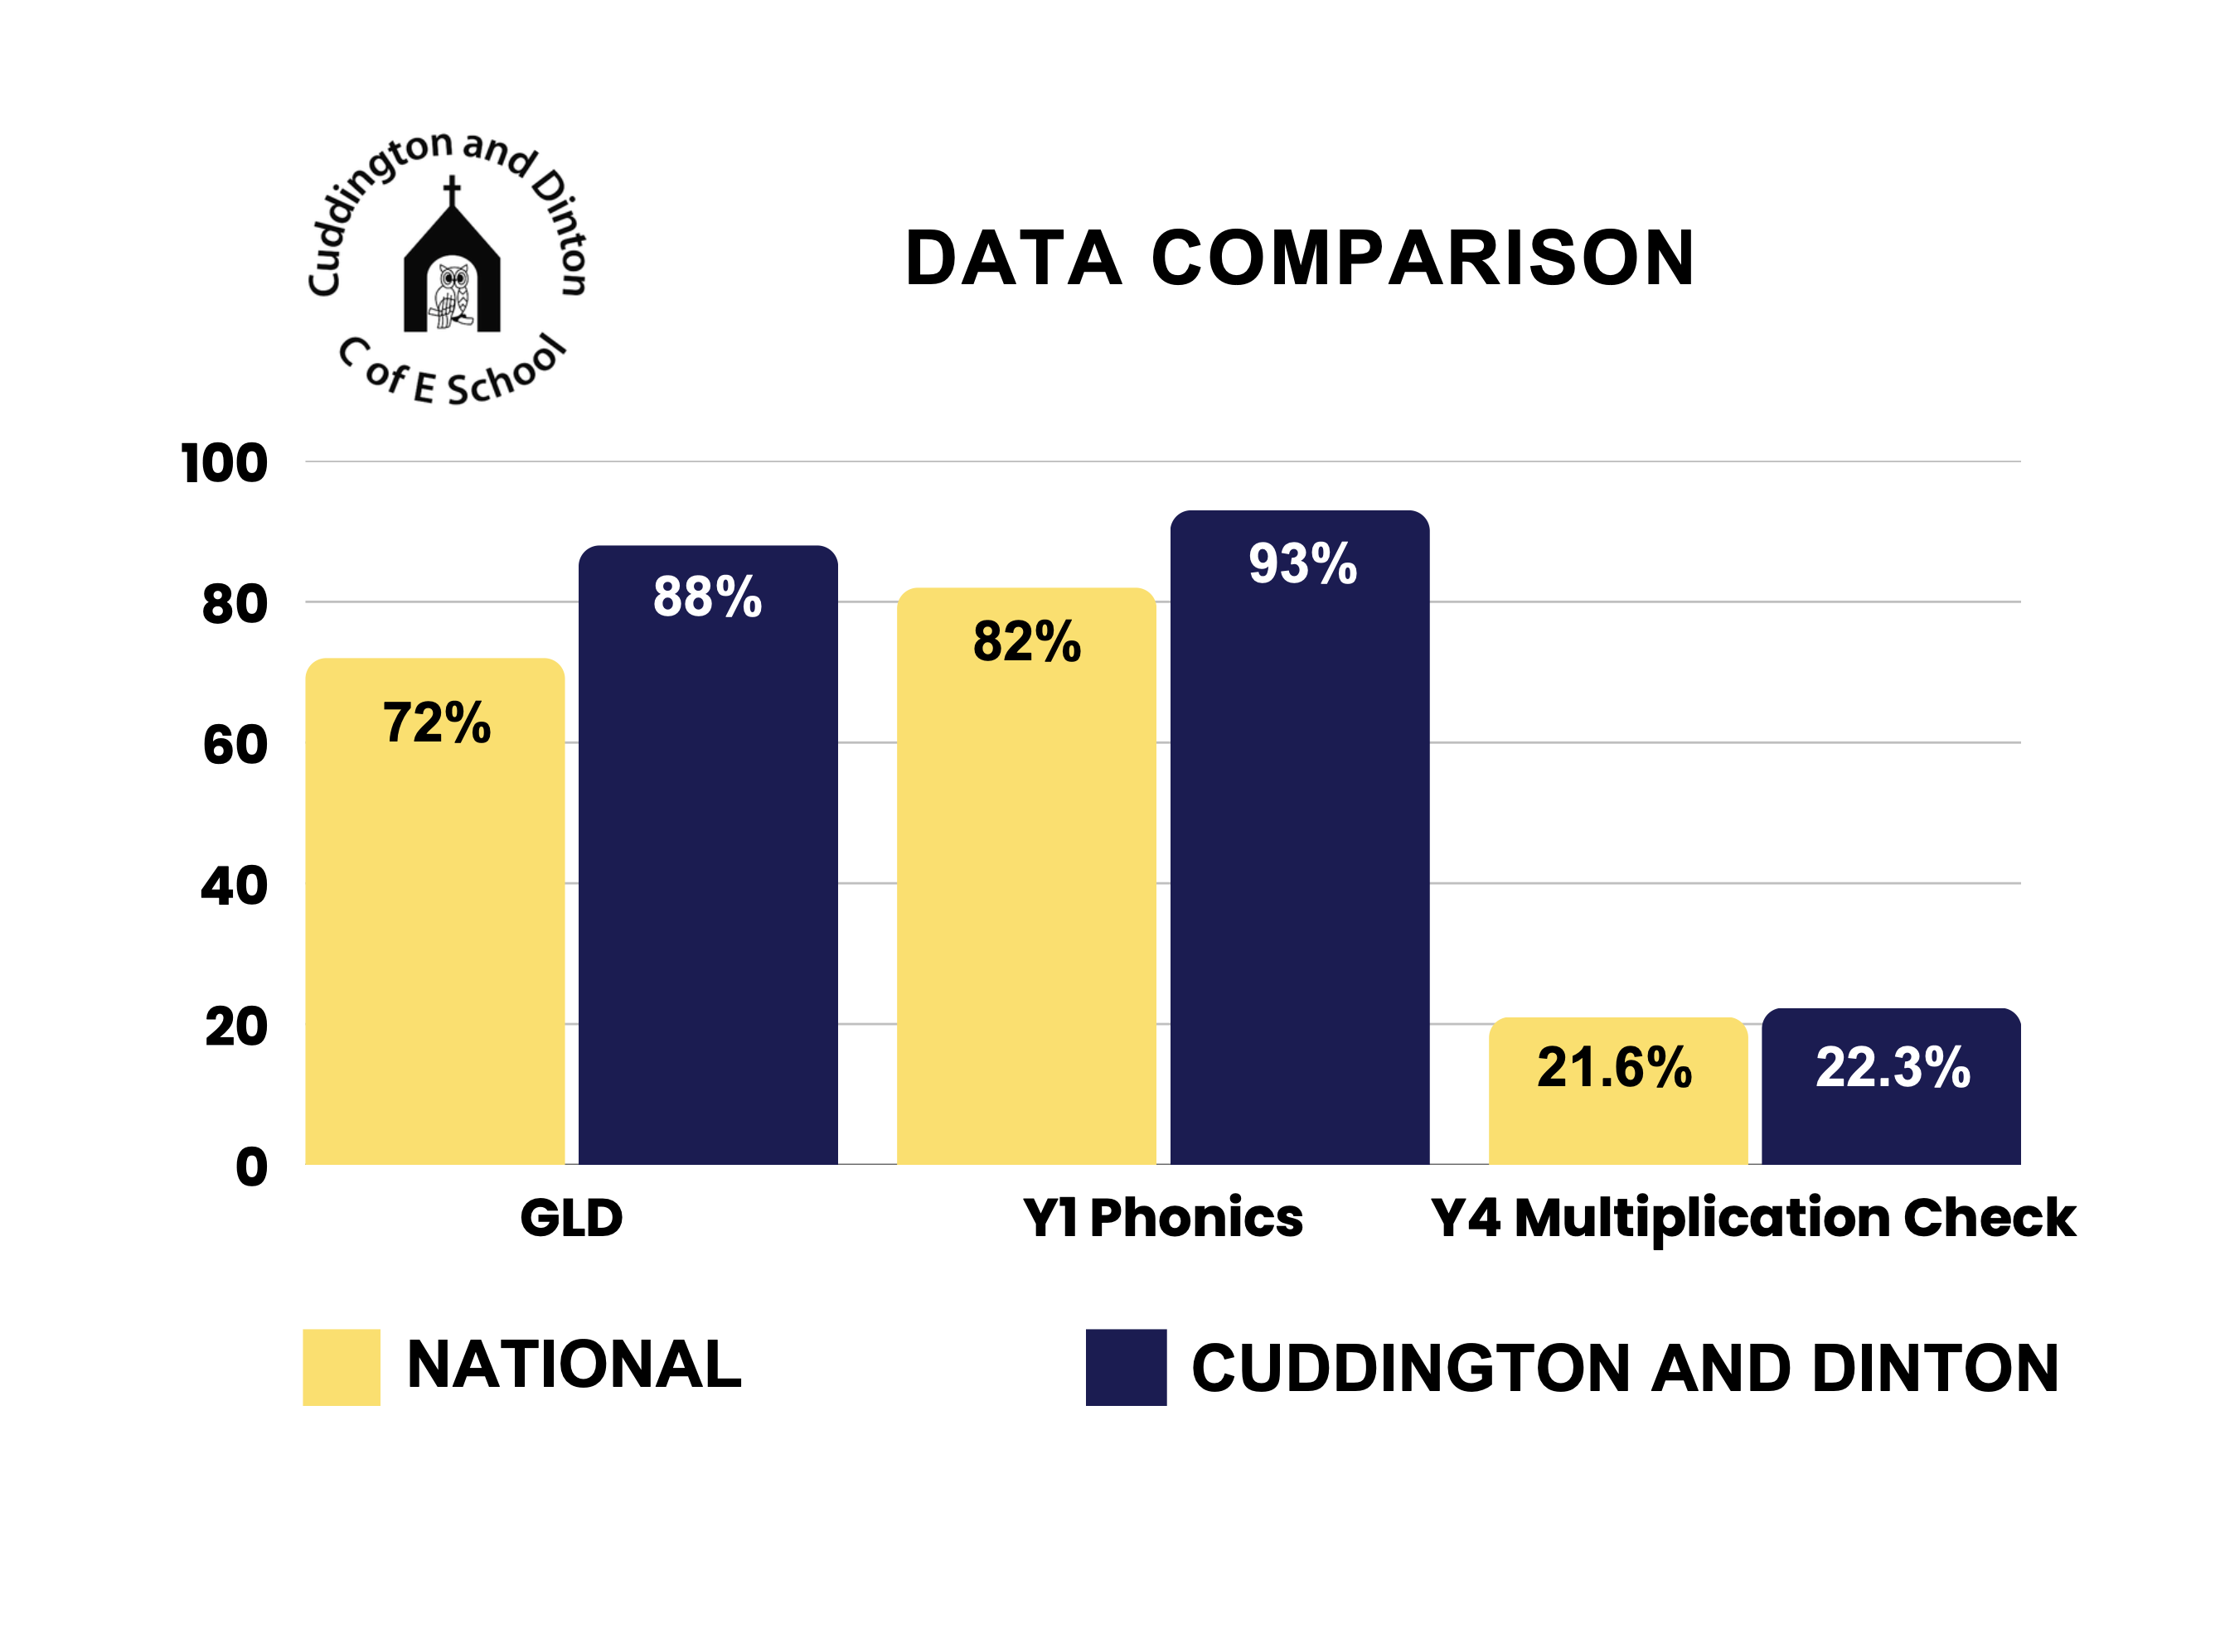

Slide 3
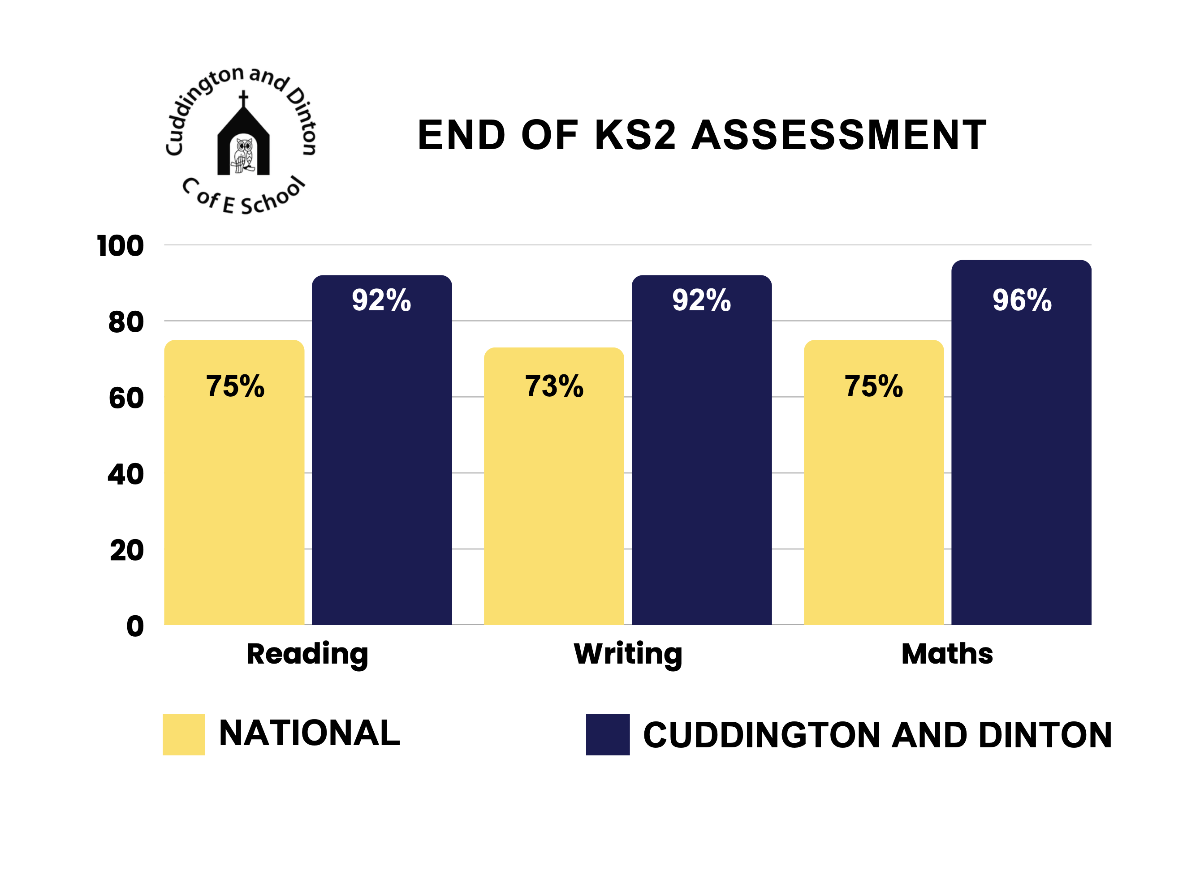

Slide 4
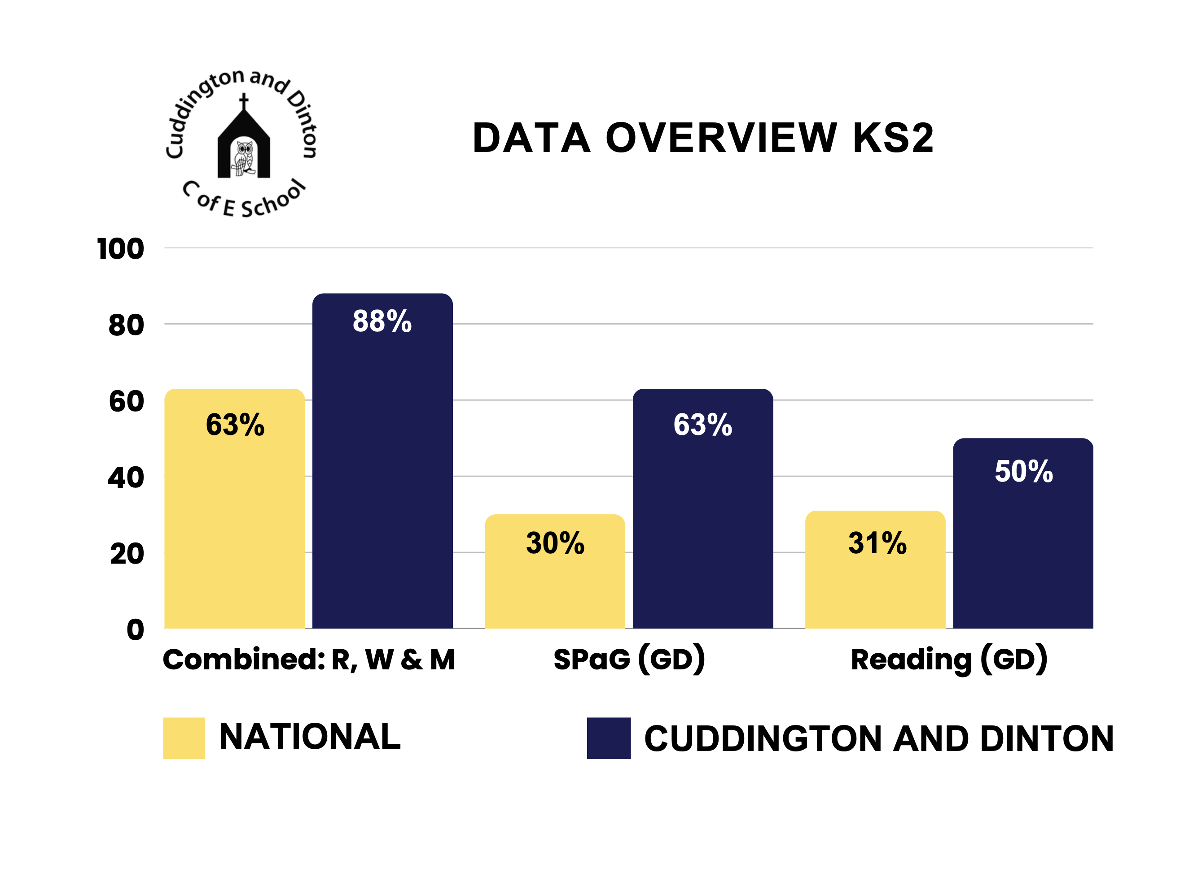

Slide 5


Slide 6
EEn
Safeguarding-
A Proactive culture of safeguarding
Strengthen oversight through analysis
Staff training needs and impact on practice
Strengthen culture of pupil safety, pupil voice and active listening

Slide 7
Inclusion-
Strengthen inclusive practice to ensure all pupils achieve, participate & flourish.
Identify pupils' needs quickly to reduce barriers.
Implement a graduated approach and ensure all staff have high-quality training.
Disadvantaged pupils’ opportunities and experiences are enhanced.

Slide 8
.
Curriculum and Teaching-
Provide a rich and inspiring curriculum that develops knowledge, curiosity and love of learning
Kinetic Letters handwriting curriculum across all year groups.
Tom Sherrington’s WalkThrus instructional strategies for highly effective classroom teaching.
Strengthen the monitoring cycle to provide astute, evidence-led decisions about curriculum quality.

Slide 9
Achievement-
Secure strong achievement for all through ambitious learning and high-quality provision.
Increase ‘Expected’ attainment in writing for boys.
Raise proportion of girls achieving Greater Depth in mathematics.
Narrow attainment gaps for disadvantaged pupils, pupils with SEND.

Slide 10
Attendance and Behaviour-
Foster a culture of respect, responsibility & regular attendance.
Raise whole-school attendance to at least 96.8% by end of Autumn term.
Reduce persistent absence with targeted pathways for identified groups.
Reduce holiday and pattern-related absences using early-warning systems and whole-school engagement.

Slide 11
Personal Development and Wellbeing
Nurture confidence, resilience, responsibility &
courageous advocates who are prepared for life.
Measuring impact of targeted pastoral intervention, including OPAL.
Gather pupil voice and impact of enrichment.
Map personal development provision to PHSE and strengthen staff delivery.

Slide 12
Quality of Education in EYFS-
Building confident, articulate & school-ready learners through targeted support, rich vocabulary & strong physical development.
Personal, Social and Emotional Development (PSED) Assessment and Targeted Intervention.
Cultural Representation and Vocabulary through Planned Texts.
Fine and gross Motor-Skills, linked to Handwriting Progression and Kinetic letters.

Slide 13
Leadership and Governance-
Strengthen leadership and Governance to drive continuous improvement & excellence.
Curriculum Implementation Assurance.
Evidence-linked Professional Development and Measurable Pupil Outcomes.
Strengthened Governance: Induction, Skills, SIAMS and Ofsted Preparedness and Governor Coaching.

