Slide 1

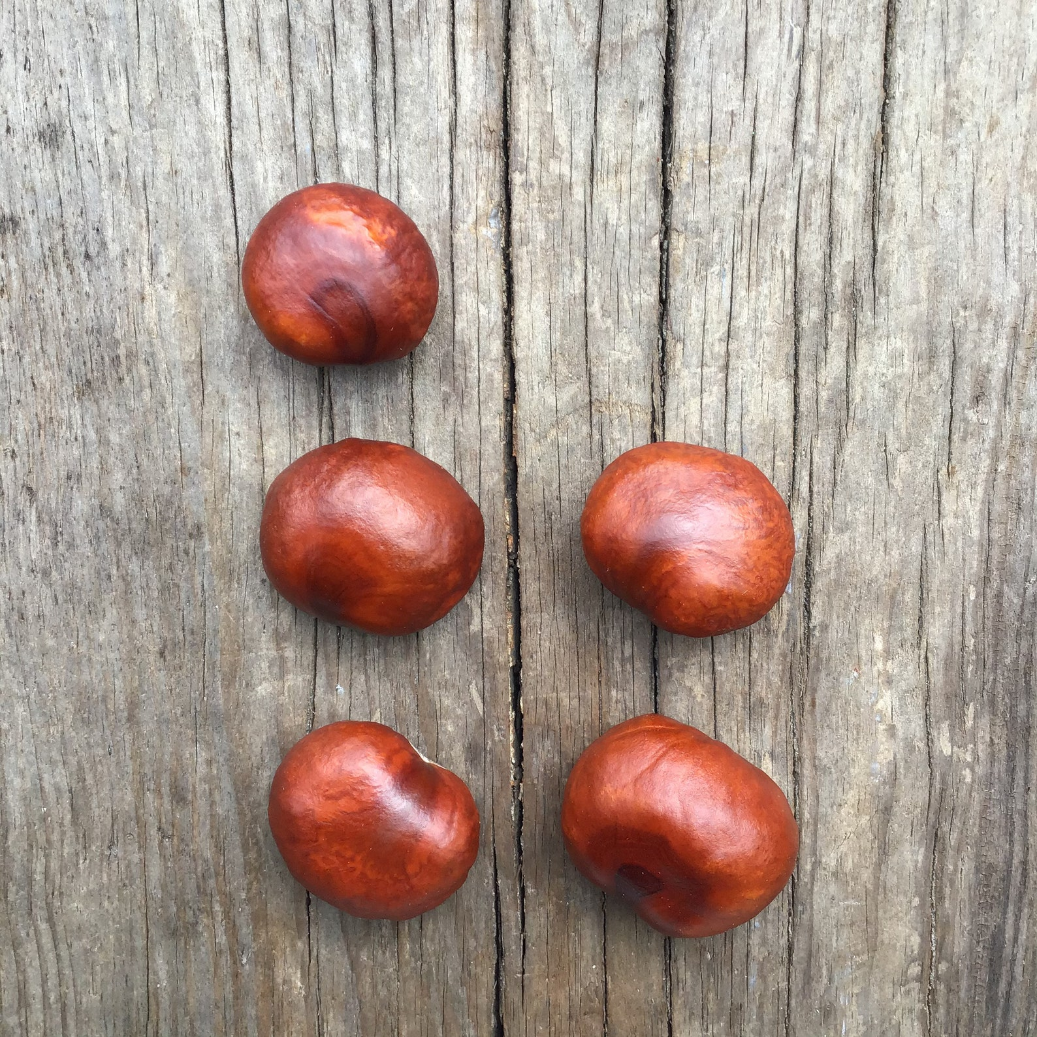


Early Maths
Parent Get-Together

Slide 2
Aims of our session today
• To give an overview of how early maths is taught at Cuddington and Dinton
• To share some of the practical resources which are used by children in maths lessons
• To share strategies to support children at home

Slide 3
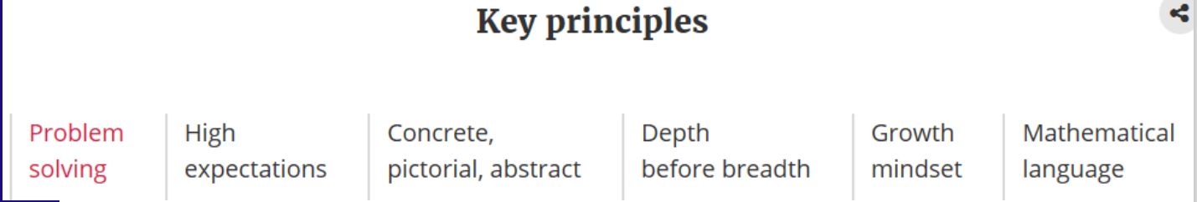
Maths Mastery Approach
Lessons and resources used develop deep conceptual understanding
Slow down learning, over learning

Slide 4
Maths in the Early Years
In the EYFS Statutory Framework Handbook it says:
“Developing a strong grounding in number is essential so that all children develop the necessary building blocks to excel mathematically. Children should be able to count confidently, develop a deep understanding of the numbers to 10, the relationships between them and the patterns within those numbers. By providing frequent and varied opportunities to build and apply this understanding - such as using manipulatives, including small pebbles and tens frames for organising counting - children will develop a secure base of knowledge and vocabulary from which mastery of mathematics is built. In addition, it is important that the curriculum includes rich opportunities for children to develop their spatial reasoning skills across all areas of mathematics including shape, space and measures. It is important that children develop positive attitudes and interests in mathematics, look for patterns and relationships, spot connections, ‘have a go’, talk to adults and peers about what they notice and not be afraid to make mistakes.”

Slide 5
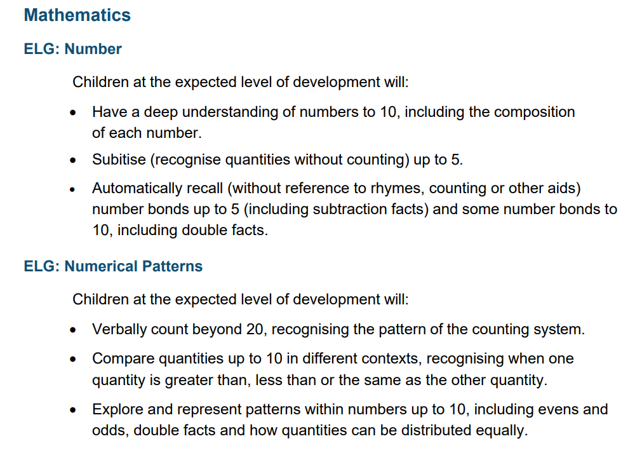

Slide 6
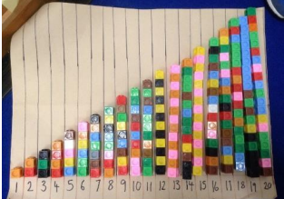
Number Sense
The focus has always been on counting. However counting is complex and takes years for children to learn to count.
It involves:
1:1 correspondence
Understanding of cardinality: (anything can be counted, understanding that the last number makes the total.
Understanding composition- what numbers are made up of
Comparing (language more/fewer, greater/less, the same
Number sequence- staircase image
Subitising is instantaneously recognising the number of objects in a small group without counting

Slide 7
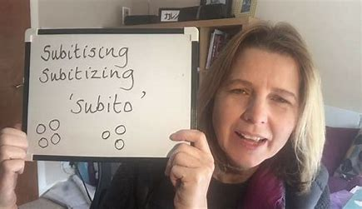
The importance of noticing
Bing Videos
Quick & SUPER EASY game to help your children learn about 'Subitising' and 'part/whole'! - YouTube

Slide 8
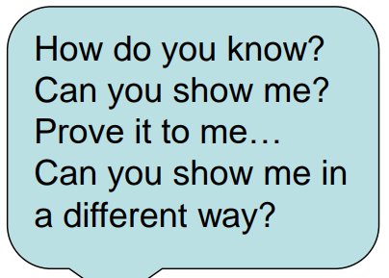
The importance of noticing
We will often ask- What can you see? How do you see it?
We encourage children to speak in full sentences- modelling through ‘I do, We do, You do’ approach.
We model key vocabulary- e.g. same, different and all staff are using this in their interactions- children learn through repetition and overlearning
Work on developing reasoning skills

Slide 9
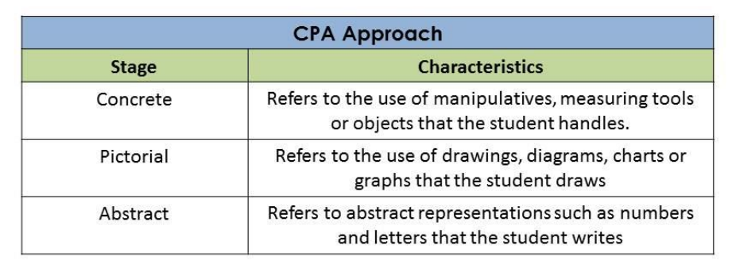

Slide 10
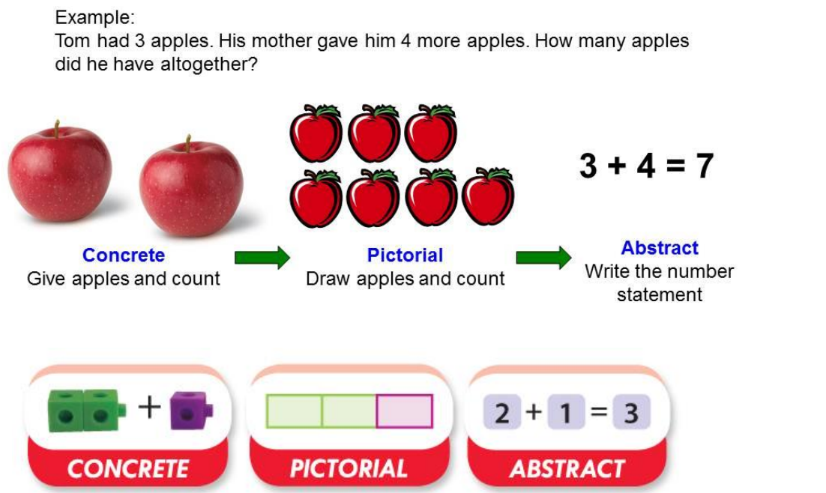

Slide 11
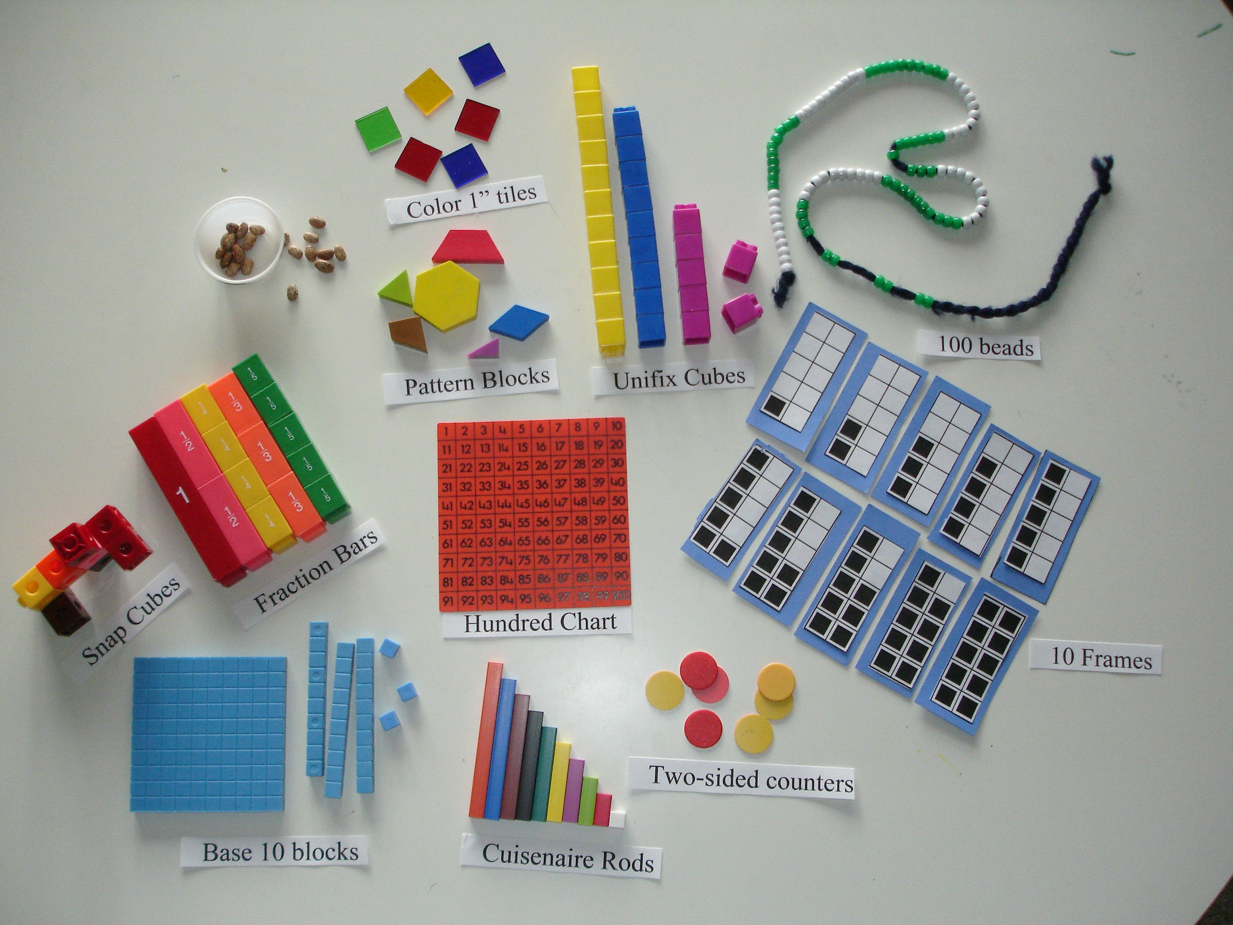
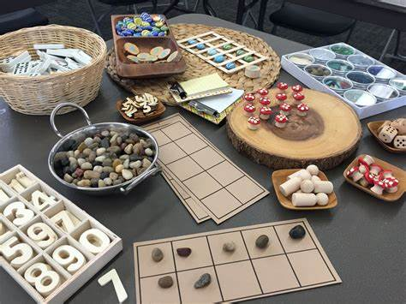
Concrete
Using manipulatives

Slide 12
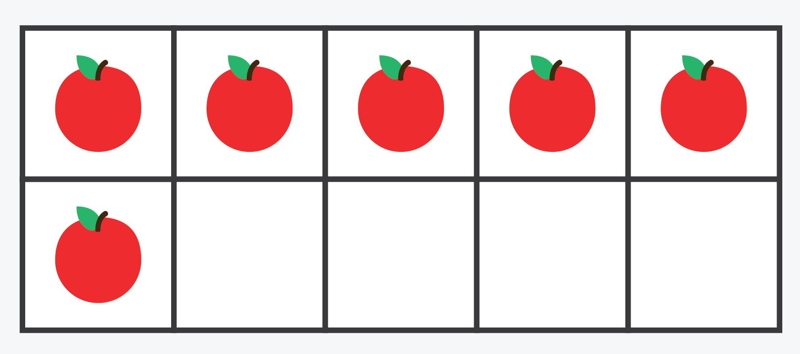



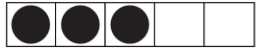
Pictorial
Building concept images

Slide 13
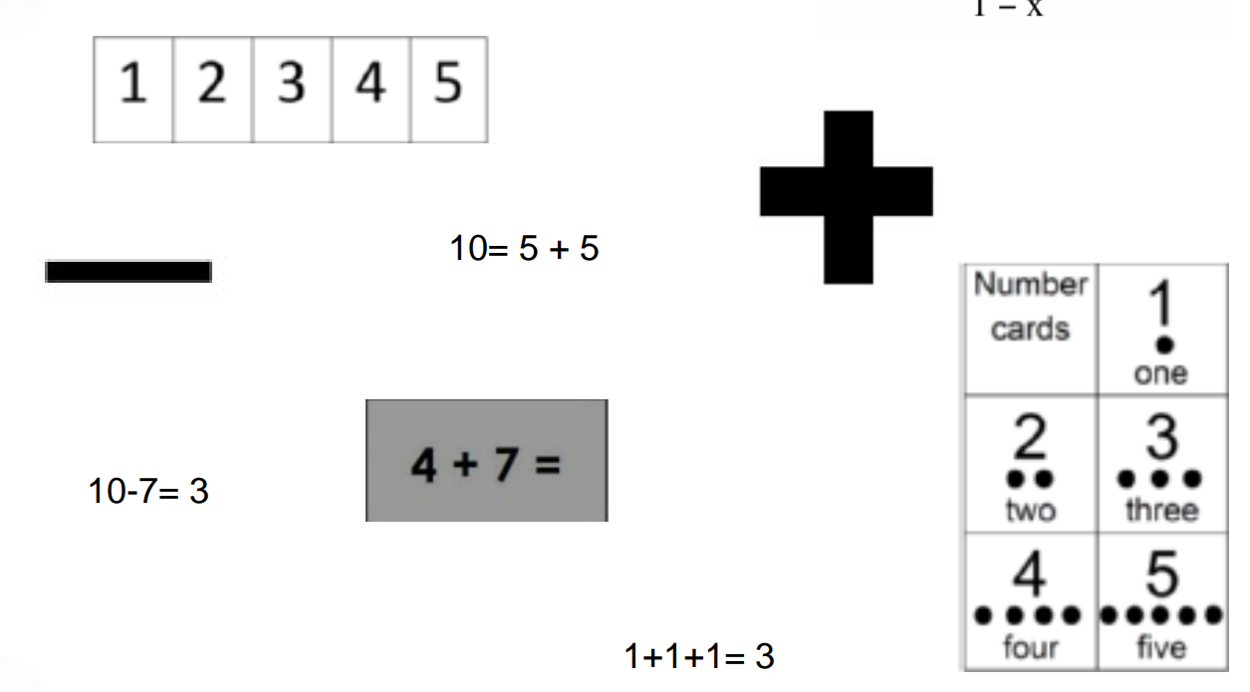
Abstract
Recording and using mathematical symbols

Slide 14
Why it is important to give children the chance to experience and make memories?
Subitising helps children to “see” amounts in their mind and rely on “memory” instead of ‘memorisation’ when learning number facts.
Question: How many 2’s in this 6?
Answer: 0? So 6 divided by 2 =0?

Slide 15

Why it is important to give children the chance to experience and make memories?
Subitising helps children to “see” amounts in their mind and rely on “memory” instead of ‘memorisation’ when learning number facts.
Question: How many 2’s in this 6?
Answer: 3 So 6 divided by 2 =3

Slide 16
Why it is important to give children the chance to experience and make memories?
Having strong concept images means that children can “see” the image in their mind, rather than trying to memorise a number fact.

Slide 17
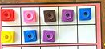
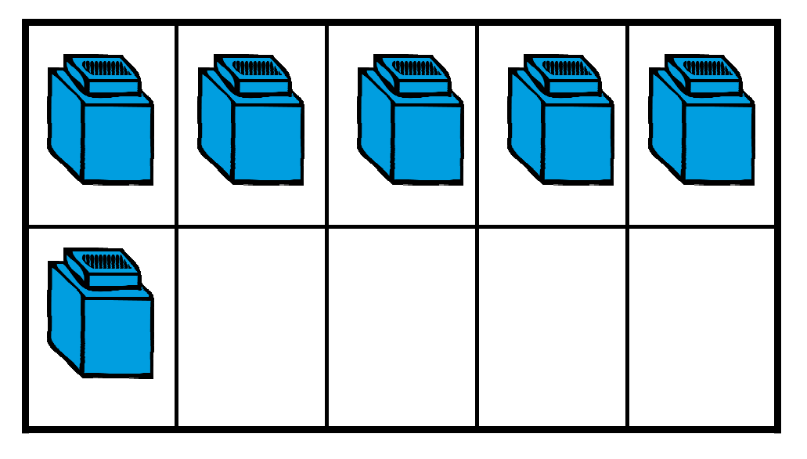
Low Cognitive Load
When using resources choose objects same size and colour to avoid distraction. It helps children to build up more secure concept images.

Slide 18
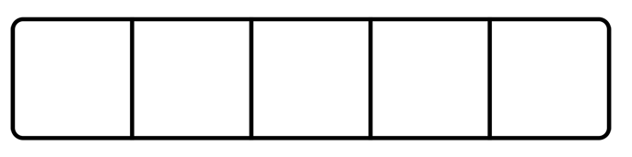
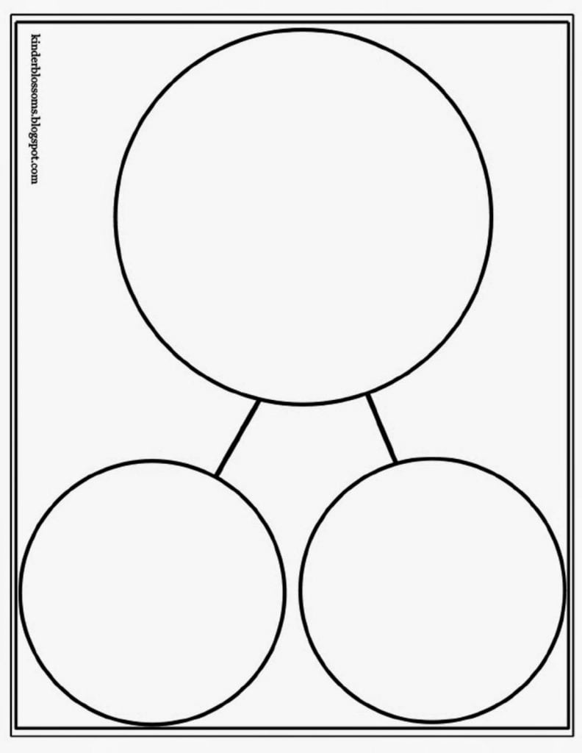
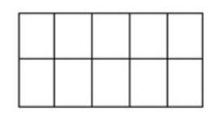
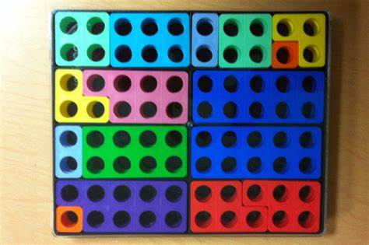
Resources we use at school

Slide 19
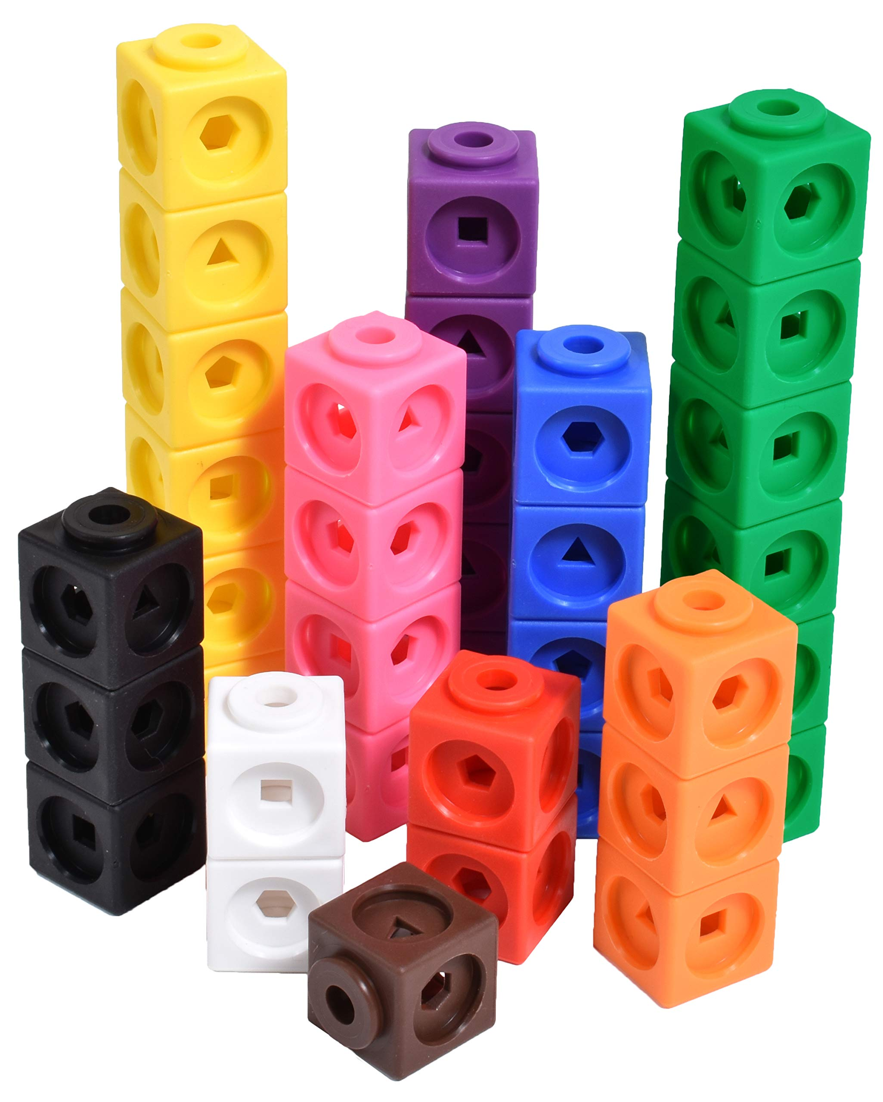

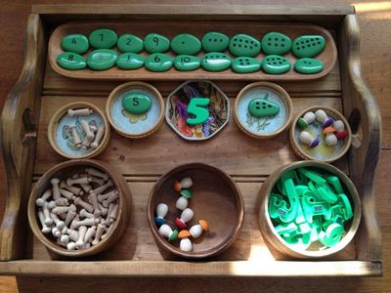
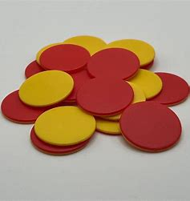
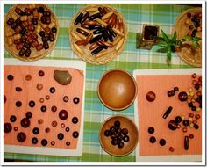
Resources we use at school

Slide 20
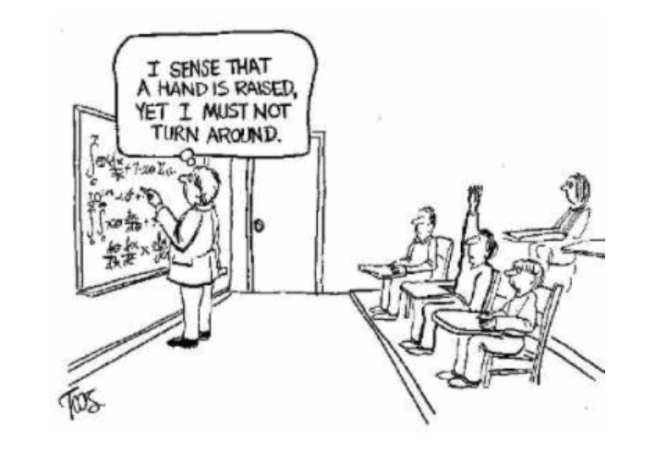
Questions

